Slide 1

Array-Based Sequences

Slide 2
Python Sequence Classes
Python has built-in types, list, tuple, and str.
Each of these sequence types supports indexing to access an individual element of a sequence, using a syntax such as A[i]
Each of these types uses an array to represent the sequence.
An array is a set of memory locations that can be addressed using consecutive indices, which, in Python, start with index 0.
A
0
1
2
i
n

Slide 3
Low-Level Arrays
Random Access Memory (RAM): Theoretically we need
O(1) time to access any location if we already know the
Address of the location.

Slide 4
Python String Representation (“SAMPLE”)
If we know
memory address at which array start
number of bytes per element
index position within the array
Desired memory address = start + cell_size * index

Slide 5
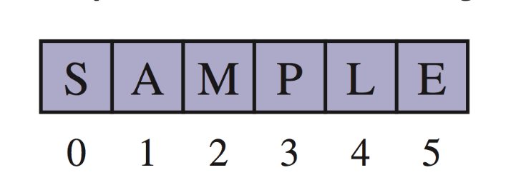
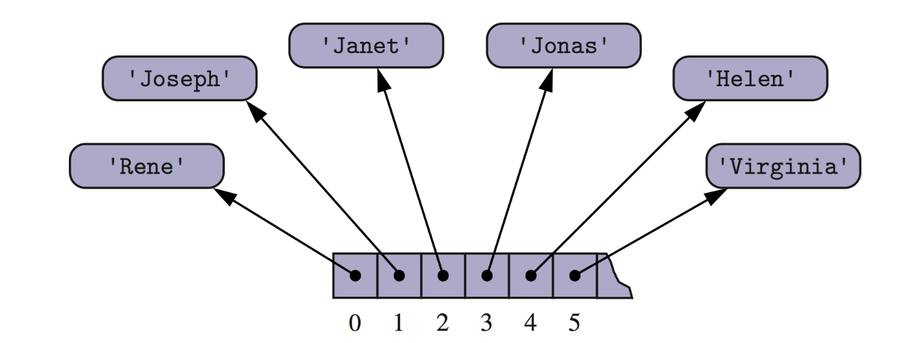
Arrays of Characters or Object References
An array can store primitive elements, such as characters, giving us a compact array.
An array can also store references to objects.

Slide 6
List Class Representation in Memory
Primes=[2,3,5,7,11,13,17,19]
Temp = Primes[3:6]

Slide 7
List Class Representation in Memory
Primes=[2,3,5,7,11,13,17,19]
Temp = Primes[3:6]
Temp[2] = 15

Slide 8
counters =[0] * 8
After executing
counters[2] +=1

Slide 9
primes.extend(extras)
primes=[2,3,5,7,11,13,17,19]
extras = [23,29,31]
Notes:
the extend command is used to add all elements from one list to the end of another list. The
extended list does not receive copies of those elements, it receives references to
those elements. Figure 5.9 portrays the effect of a call to extend.

Slide 10
Shallow Copy, Copy using Slice Operator and Deep Copy of List
>>> colours1 = ["red", "green"]
>>> colours2 = colours1
>>> colours2 = ["rouge", "vert"]
>>> print(colours1)

Slide 11
Shallow Copy, Copy using Slice Operator and Deep Copy of List
>>> colours1 = ["red", "green"]
>>> colours2 = colours1
>>> colours2 = ["rouge", "vert"]
>>> print(colours1)
Output: [‘red’, ‘green’]

Slide 12
>>> colours1 = ["red", "green"]
>>> colours2 = colours1
>>> colours2[1] = "blue"
>>> print(colours1)

Slide 13
>>> colours1 = ["red", "green"]
>>> colours2 = colours1
>>> colours2[1] = "blue"
>>> print(colours1)
Output: [‘red’, ‘blue’]

Slide 14
Copy with the Slice Operator
>>> list1 = ['a','b','c','d']
>>> list2 = list1[:]
>>> list2[1] = 'x'
>>> print(list2)
>>> print(list1)

Slide 15
Copy with the Slice Operator
>>> lst1 = ['a','b',['ab','ba']]
>>> lst2 = lst1[:]
>>> lst2[0] = 'c'
>>> lst2[2][1] = 'd'
>>> print(lst1)

Slide 16
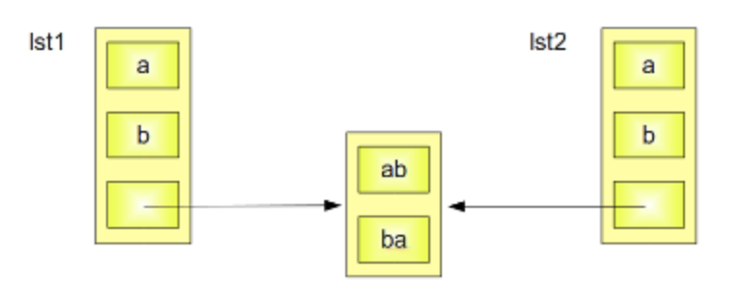
Copy with the Slice Operator
>>> lst1 = ['a','b',['ab','ba']]
>>> lst2 = lst1[:]

Slide 17
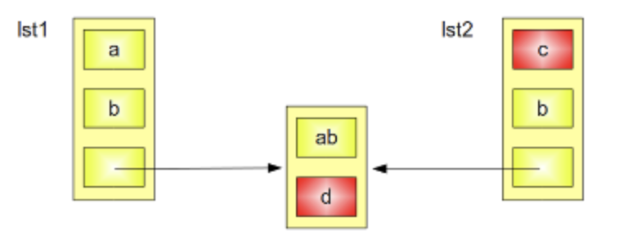
Copy with the Slice Operator
>>> lst1 = ['a','b',['ab','ba']]
>>> lst2 = lst1[:]
>>> lst2[0] = 'c'
>>> lst2[2][1] = 'd'
>>> print(lst1)

Slide 18
Using deepcopy from copy module
from copy import deepcopy
lst1 = ['a','b',['ab','ba']]
lst2 = deepcopy(lst1)
lst2[2][1] = "d"
lst2[0] = "c"
print(lst2)
print(lst1)

Slide 19
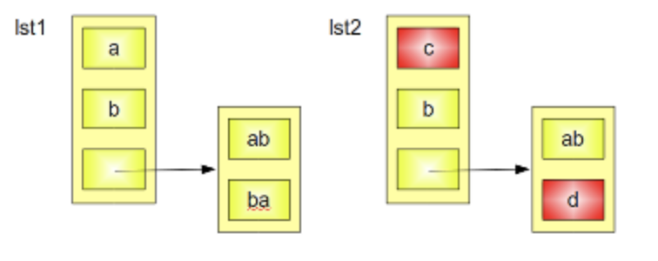
Using deepcopy from copy module
from copy import deepcopy
lst1 = ['a','b',['ab','ba']]
lst2 = deepcopy(lst1)
lst2[2][1] = "d"
lst2[0] = "c"
print(lst2)
print(lst1)

Slide 20
Compact Arrays
Primary support for compact arrays is in a module named array.
That module defines a class, also named array, providing compact storage for arrays of primitive data types.
The constructor for the array class requires a type code as a first parameter, which is a character that designates the type of data that will be stored in the array.

Slide 21
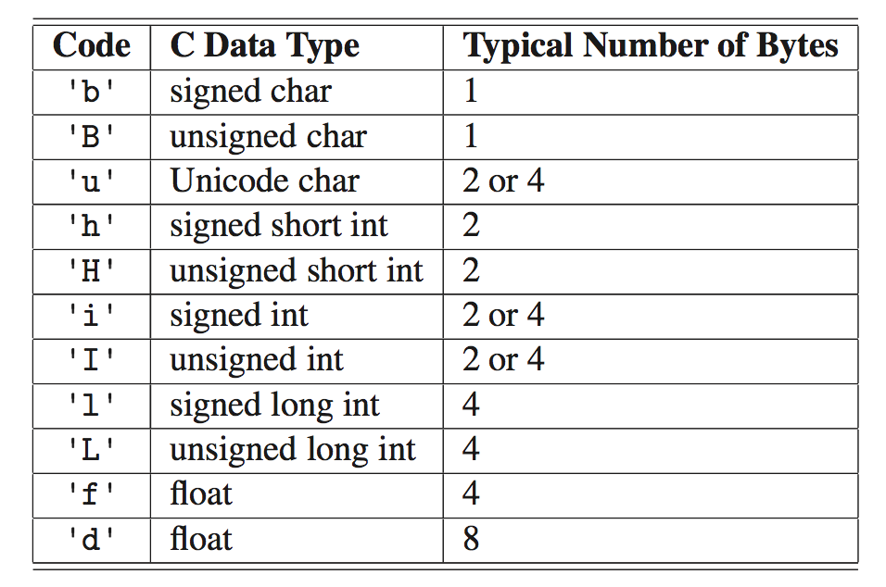
Type Codes in the array Class
Python’s array class has the following type codes:

Slide 22
Dynamic Array and Amortization
When creating a low-level array in a computer system, the precise size of that array must be explicitly declared in order for the system to properly allocate a consecutive piece of memory for its storage.
Otherwise system might dedicate neighboring memory locations to store other data, the capacity of an array cannot trivially be increased by expanding into subsequent cells.
For Immutable classes like tuple or str instance, this is no problem.

Slide 23
Python List Class
Dynamic Array
Underlying array has more capacity than current length of the list.
If full, create a new array with larger capacity, and then copy the elements from old array to new array.
Old array is no longer needed. System can claim that memory space.

Slide 24
Experimental Analysis (open experiment_list_size.py file)
import sys
try:
n = int(sys.argv[1])
except:
n = 100
data = []
for k in range(n): # NOTE: must fix choice of n
a = len(data) # number of elements
b = sys.getsizeof(data) # actual size in bytes print('Length: {0:3d}; Size in bytes:{1:4d}'.format(a,b))
data.append(None) # increase length by one

Slide 25
Output

Slide 26
Implementation of a Dynamic Array
1. Allocate a new array B with larger capacity.
2. Set B[i] = A[i], for i = 0, . . . ,n−1, where n denotes
current number of items.
3. Set A = B, that is, we henceforth use B as the
array supporting the list.
4. Insert the new element in the new array.

Slide 27
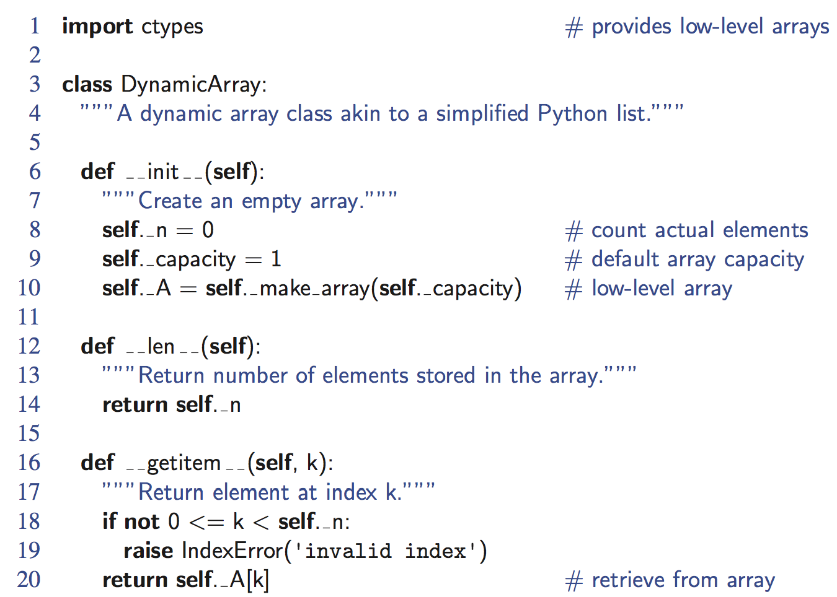
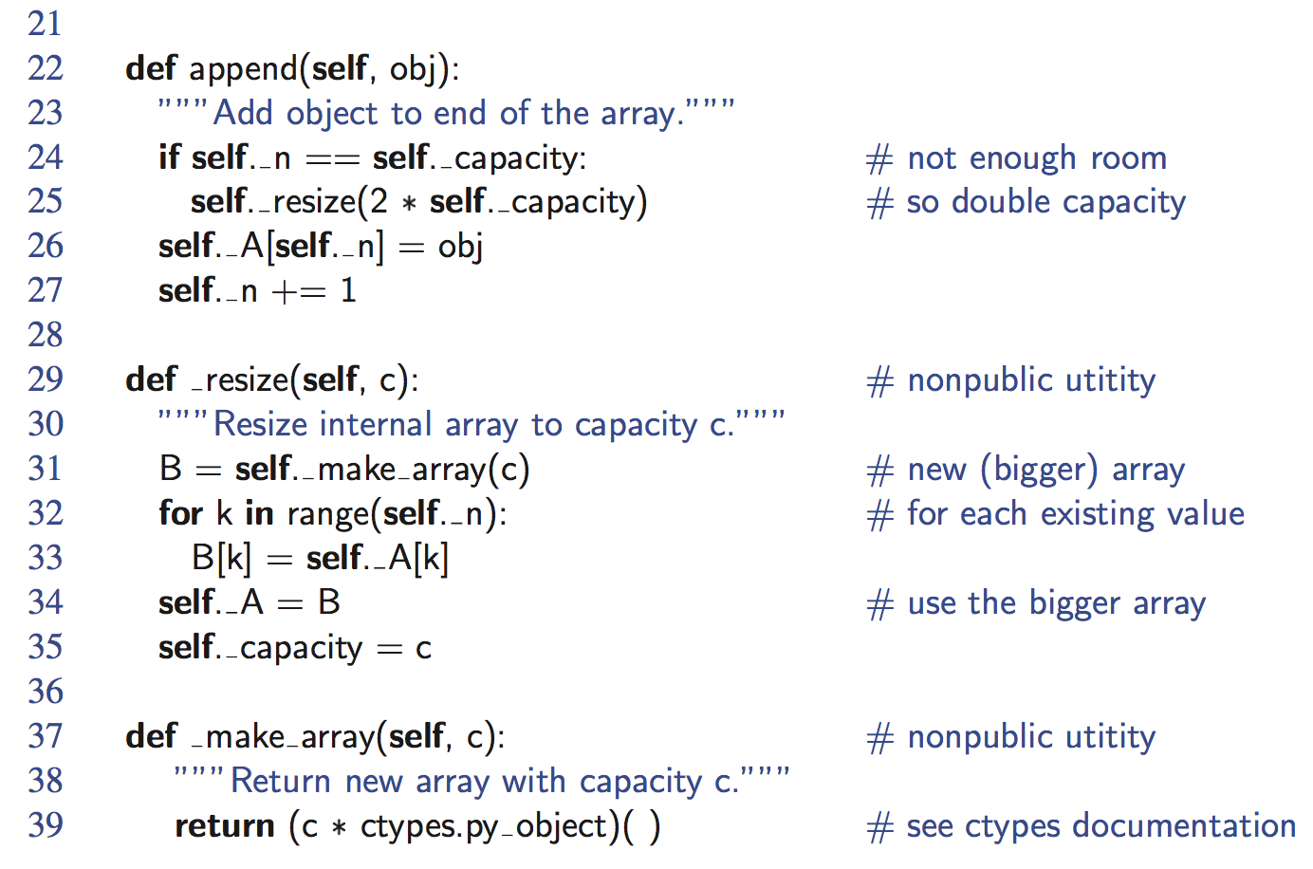
Python Implementation

Slide 28
Growable Array-based Array List
In an add(o) operation (without an index), we could always add at the end
When the array is full, we replace the array with a larger one
How large should the new array be?
Incremental strategy: increase the size by a constant c
Doubling strategy: double the size
Algorithm add(o)
if t = S.length − 1 then
A ← new array of
size …
for i ← 0 to n−1 do
A[i] ← S[i]
S ← A
n ← n + 1
S[n−1] ← o

Slide 29
Comparison of the Strategies
We compare the incremental strategy and the doubling strategy by analyzing the total time T(n) needed to perform a series of n add(o) operations
We assume that we start with an empty stack represented by an array of size 1
We call amortized time of an add operation the average time taken by an add over the series of operations, i.e., T(n)/n

Slide 30
Incremental Strategy

Slide 31
Incremental Strategy Analysis
We replace the array k = n/c times
The total time T(n) of a series of n add operations is proportional to
n + c + 2c + 3c + 4c + … + kc =
n + c(1 + 2 + 3 + … + k) =
n + ck(k + 1)/2
Since c is a constant, T(n) is O(n + k²), i.e., O(n²)
The amortized time of an add operation is O(n)

Slide 32
Always Doubling Strategy

Slide 33
Doubling Strategy Analysis
We replace the array k = log₂ n times
The total time T(n) of a series of n add operations is proportional to
n + 1 + 2 + 4 + 8 + …+ 2^{k} = n + 2^{k + 1} − 1 =
3n − 1
T(n) is O(n)
The amortized time of an add operation is O(1)
geometric series
2
4
1
1
8

Slide 34
Average Running Time Append Operation over n call

Slide 35
Asymptotic Performance of Nonmutating Behaviors

Slide 36
Asymptotic Performance of mutating behavior

Slide 37
Insertion
In an operation add(i, o), we need to make room for the new element by shifting forward the n − i elements A[i], …, A[n − 1]
In the worst case (i = 0), this takes O(n) time
A
0
1
2
i
n
A
0
1
2
i
n
A
o
0
1
2
i
n

Slide 38
Element Removal
In an operation remove(i), we need to fill the hole left by the removed element by shifting backward the n − i − 1 elements A[i + 1], …, A[n − 1]
In the worst case (i = 0), this takes O(n) time
A
o
0
1
2
i
n
A
0
1
2
i
n
A
0
1
2
i
n

Slide 39
Performance
In an array based implementation of a dynamic list:
The space used by the data structure is O(n)
Indexing the element at I takes O(1) time
add and remove run in O(n) time in worst case
In an add operation, when the array is full, instead of throwing an exception, we can replace the array with a larger one…

Slide 40
Composing Large Strings

Slide 41
Creating a Multidimensional list
Data[1][3] represents the value at row number 1
And Column number 3.
Notes:
A common representation for a two-dimensional data set in Python is as a list
of lists. In particular, we can represent a two-dimensional array as a list of rows,
with each row itself being a list of values. For example, the two-dimensional data

Slide 42
Creating a Two Dimensional List
Two dimensional list of integers with r rows and c columns with initialize all values to 0.
data = ([0] * c) * r
Flawed Approach. Why???
data = [[0]*c]*r
Flawed Approach too. Why???
Notes:
While([0]*c) is indeed a list of c zeros, multiplying that list by r unfortunately creates
a single list with length r · c, just as [2,4,6]*2 results in list [2, 4, 6, 2, 4, 6]. Still a one dimensional array with length c*r.
This is much closer, as we actually do have a structure that is formally a list of lists.
The problem is that all r entries of the list known as data are references to the same
instance of a list of c zeros. Figure 5.23 provides a portrayal of such aliasing.

Slide 43
Creating a Two Dimensional List
A flawed representation of a 3×6 data set as a list of lists,
created with the command data = [ [0]*6 ]*3.
(For simplicity, we overlook the fact that the values in the
secondary list are referential.)
Notes:
This is truly a problem. Setting an entry such as data[2][0] = 100 would change
the first entry of the secondary list to reference a new value, 100. Yet that cell of
the secondary list also represents the value data[0][0], because “row” data[0] and
“row” data[2] refer to the same secondary list.

Slide 44
Creating a Two Dimensional List
data = [ [0]*c for j in range(r) ]
A valid representation of a 3×6 data set as a list of lists.
Notes:
This is truly a problem. Setting an entry such as data[2][0] = 100 would change
the first entry of the secondary list to reference a new value, 100. Yet that cell of
the secondary list also represents the value data[0][0], because “row” data[0] and
“row” data[2] refer to the same secondary list.

Slide 45
Coding Practice
Creating our own dynamic array.
Open the UserDefinedDynamicArray.py file.
Some functions are already implemented.
append(), getitem, delitem, len, str,resize,make_array

Slide 46
Practice UserDefinedDynamic Array Class.
Task1:
Implement is_empty(self)
Implement __iter__(self)
Task2:
Implement __setitem__(self,I,x)

Slide 47
Practice UserDefinedDynamic Array Class.
Task3:
Implement extend(self,I)
Task4:
Implement reverse(self)

Slide 48
Practice UserDefinedDynamic Array Class.
Task5:
Implement __contains__(self,x)
Implement index(self,x)
Implement count(self,x)
Task6:
Implement __add__(self,other)
Implement __mul__(self,times)

Slide 49
Practice UserDefinedDynamic Array Class.
Task7:
Implement __pop__(self,i=-1)
Implement remove(self,x)

Slide 50
Using Array Based Sequences
Storing High Scores of a game
Simple Cryptography
Multidimensional Array
Tic Tac Toe game

